Slide 1



Leveraging Large Language Models for Enhanced E-commerce Applications
By：:Zhang Gaoxing

Slide 2

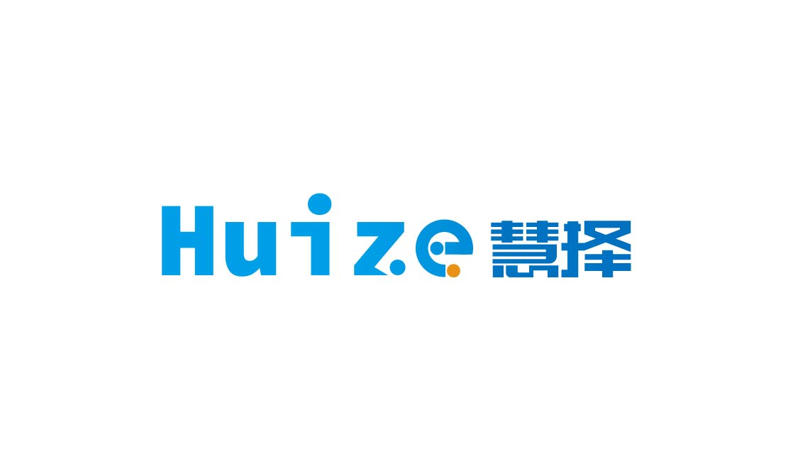

ABOUT US
Huicast Telecom (Huize) is a Hong Kong-registered cloud computing and BGP solution provider, and a member of RIPE and MANRS.
Non-profit Project Website: www.huize.asia
For-profit Project Website: www.huicast.com

Slide 3
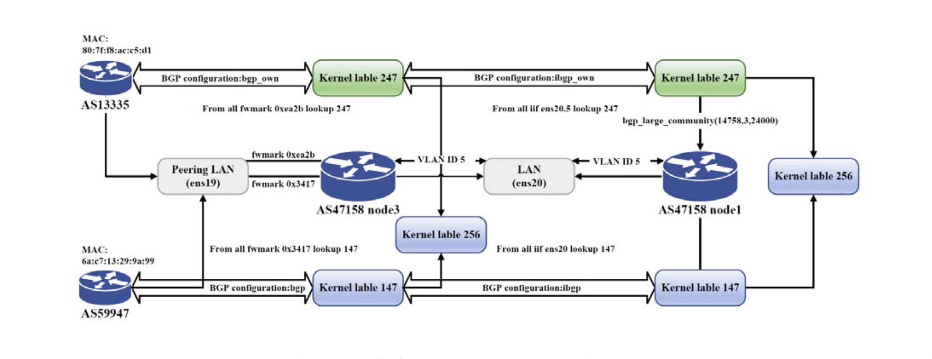
OUR BUSINESS
We specialise in providing BGP solutions for the foundational network architecture of small and medium-sized enterprises (SMEs). Our services support company-owned data center routers and IP Transit providers. Currently, we are official members of MANRS and RIPE.

Slide 4

About MANRS and RIPE
MANRS (Mutually Agreed Norms for Routing Security) is a global initiative aimed at improving internet routing security through a set of best practices.
Members of MANRS include globally recognised technology companies and internet service providers, such as industry giants Huawei and Amazon.

Slide 5

About MANRS and RIPE
RIPE (Réseaux IP Européens) is an open community of network operators, suppliers, and researchers dedicated to ensuring the continuous development and operation of the internet.
Members of RIPE include network operators, service providers, enterprises, and academic institutions. As a RIPE member, our company can participate in policy-making and access the latest information on network technologies and resource allocation.

Slide 6



Our AI partner: Command AI Limited
http://commandai.tech

Slide 7
ABOUT OUR PARTNER
Command AI is an artificial intelligence company based in Hong Kong. Established in 2024, we are a provider of advanced AI solutions and services for both businesses (B2B) and individual consumers (B2C). Our company is funded by Hong Kong Science and Technology Park (HKSTP) and The Hong Kong Polytechnic University (PolyU).
Our diverse team is composed of top talent from prestigious institutions such as the Hong Kong Polytechnic University, the Chinese University of Hong Kong, the City University of Hong Kong, and the University of Oxford. With backgrounds spanning computer science, mathematics, and more, our experts are at the forefront of AI research and development.
Combining cutting-edge technology with deep domain expertise, Command AI delivers innovative and impactful AI-powered solutions to clients across a wide range of industries. From intelligent automation to predictive analytics, our capabilities empower organizations to unlock new opportunities and drive sustainable growth. For individual users, our AI-infused products and services enhance productivity, provide personalized experiences, and unlock new possibilities.

Slide 8
Sales Assistance AI
For proactive marketing efforts, such as email marketing, customer inquiries, and social media marketing, sales personnel typically send dozens of communications a day. Large language models and other AI technologies can reduce the workload and filter out genuinely interested clients.

Slide 9
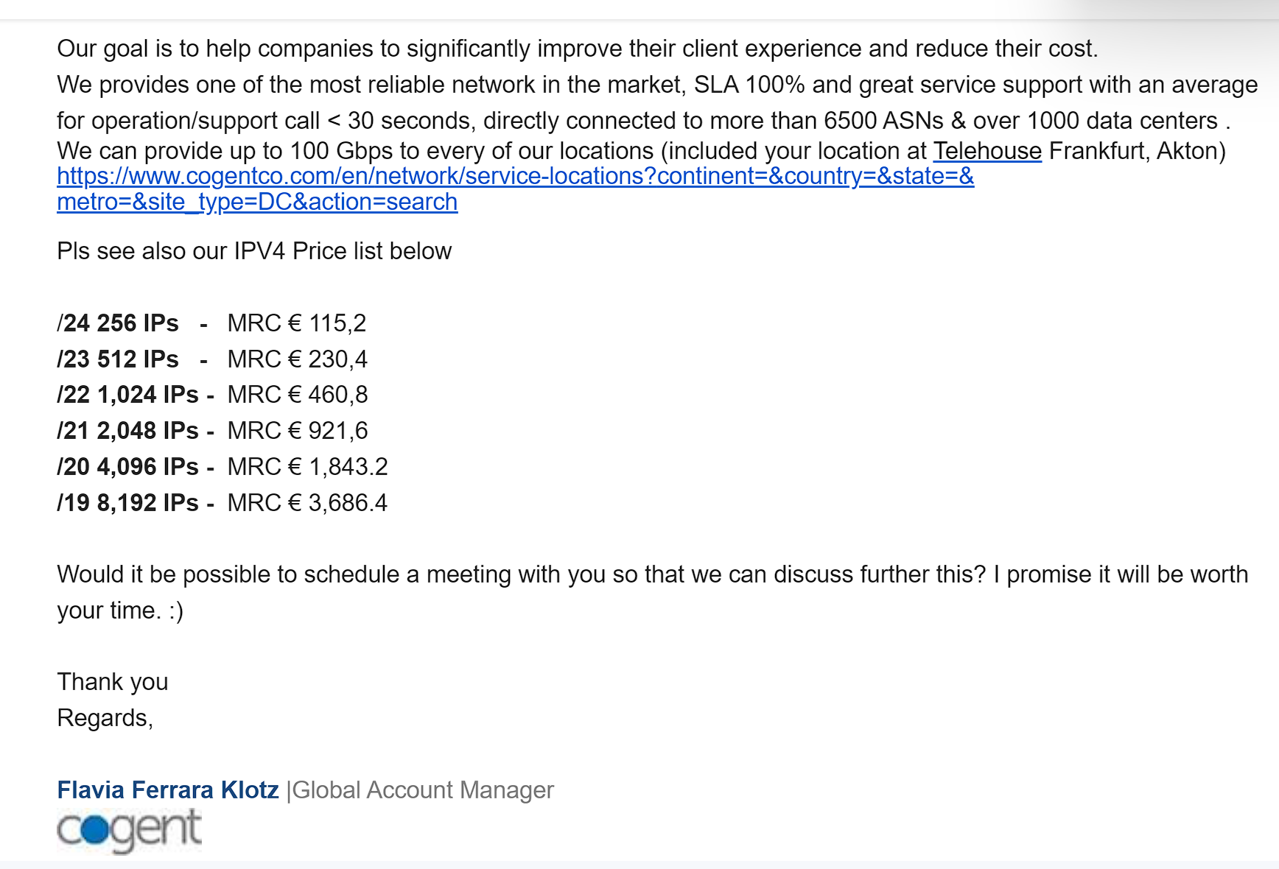
Cogent Communications: Sales Challenges
Company Overview: Cogent Communications is a leading US multinational telecommunications provider. Its sales team faces significant hurdles in efficiently managing customer outreach and lead qualification, impacting overall sales performance.

Slide 10
Cogent Communications: Sales Challenges
Key Challenges:
High-volume, low-efficiency email outreach
Lack of automated lead qualification
Inconsistent follow-up processes
Difficulty in identifying high-potential leads
Scalability issues as the company grows
These challenges result in reduced conversion rates and hinder the company's ability to meet growth targets in the competitive telecommunications market.

Slide 11
AI-Powered Sales Automation Solutions
Intelligent Prospect Identification
AI analyzes company websites and public data
Automatically identifies potential customers
• Collects contact information (e.g., email addresses)
Automated Follow-up
AI-driven bots monitor communication patterns
Sends timely inquiries for non-responsive customers
Maintains engagement without manual intervention
Smart Lead Qualification
AI detects buying signals (e.g., price negotiations, detailed inquiries)
Prioritizes interested customers
Seamlessly transfers qualified leads to human representatives

Slide 12
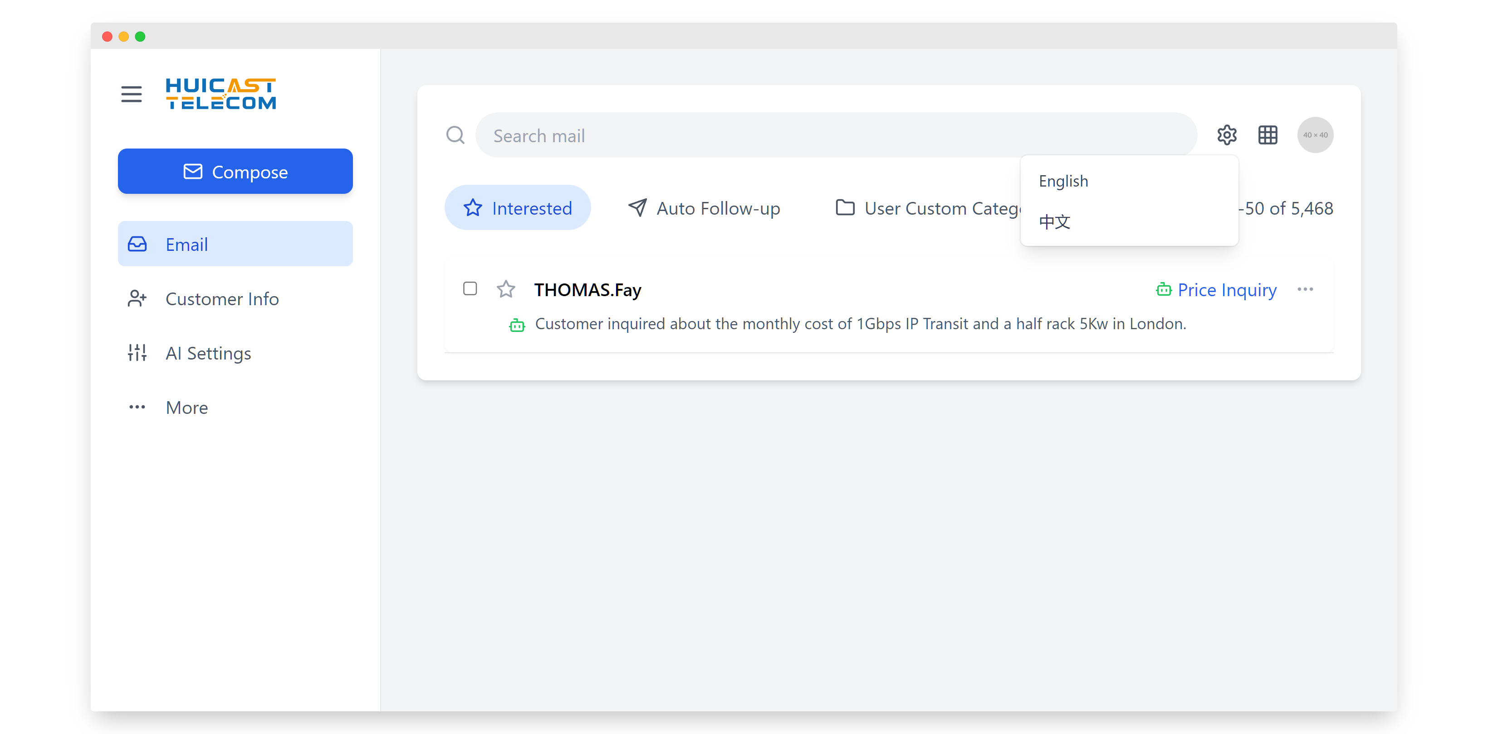
B2B Sales AI Assistant Demo
Start

Slide 14
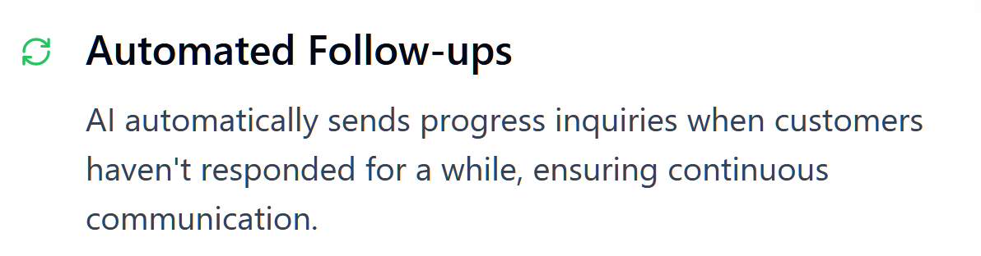
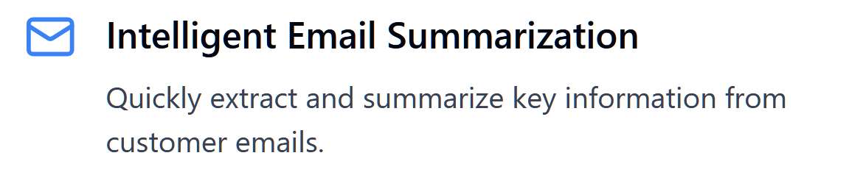
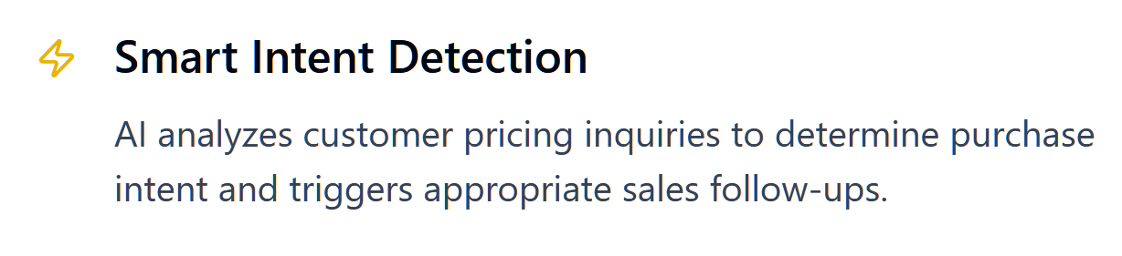

Slide 16
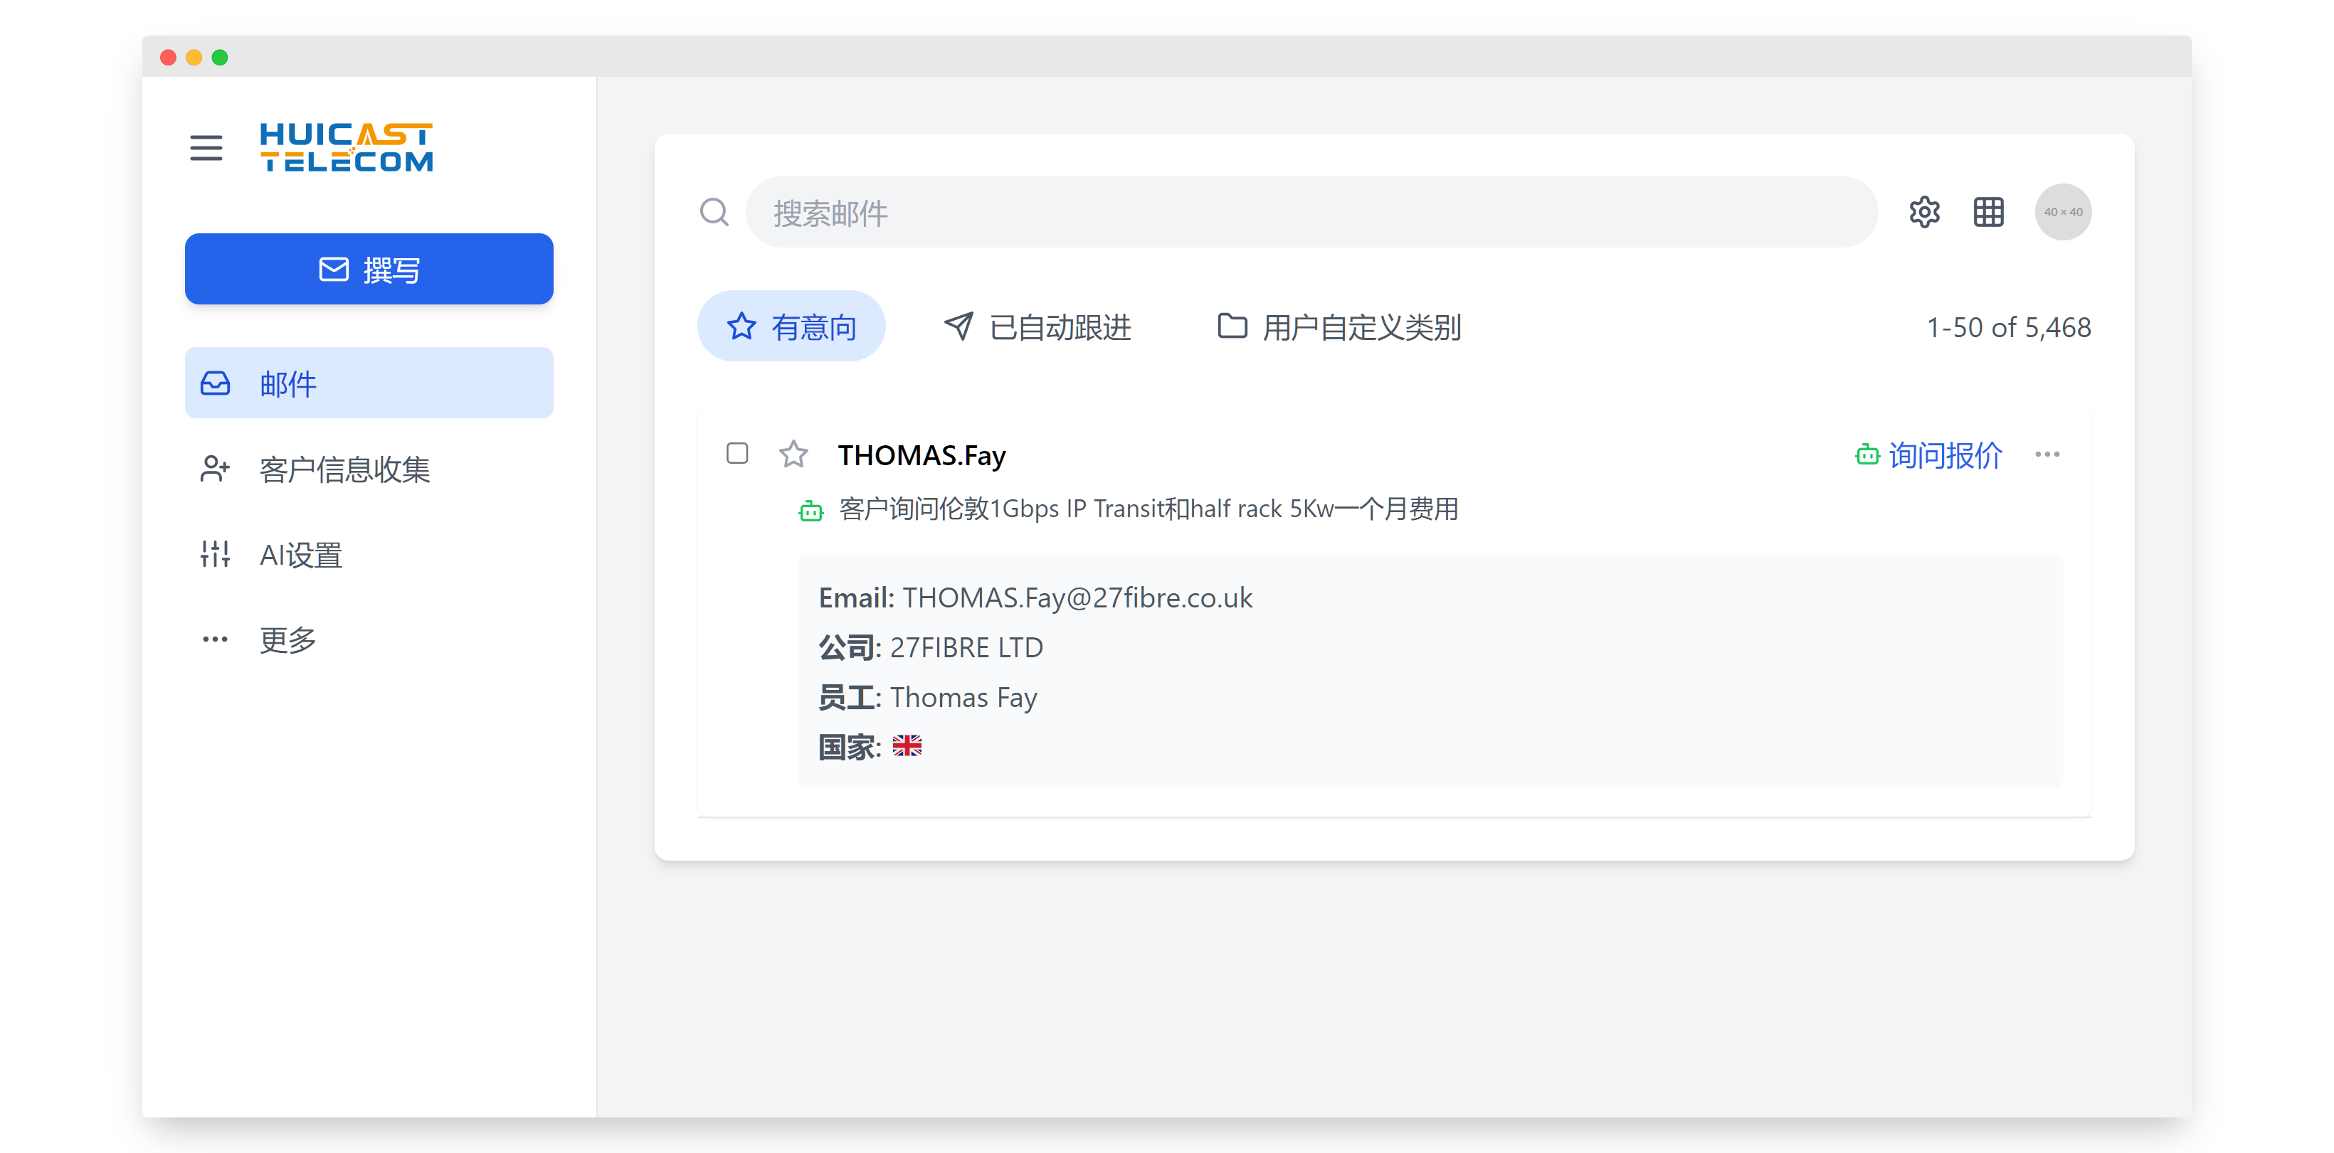
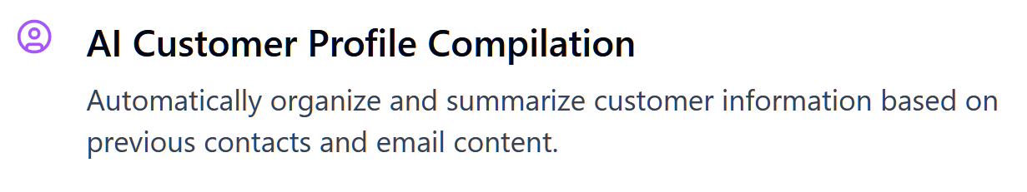

Slide 17
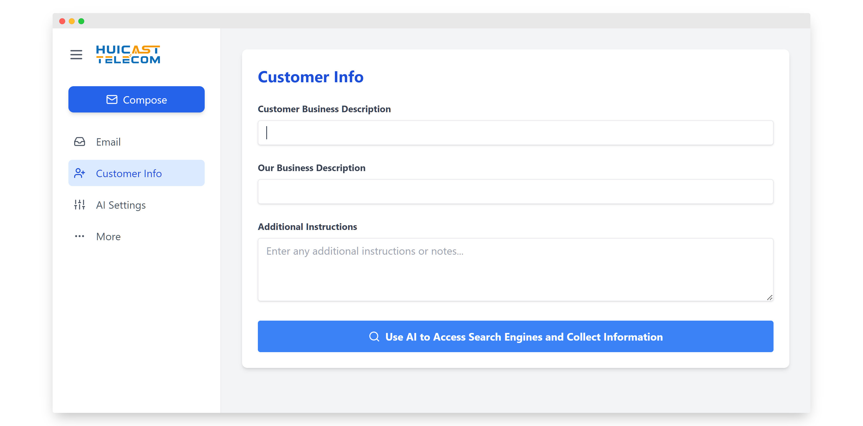
AI Potential Customer Discovery System

Slide 18
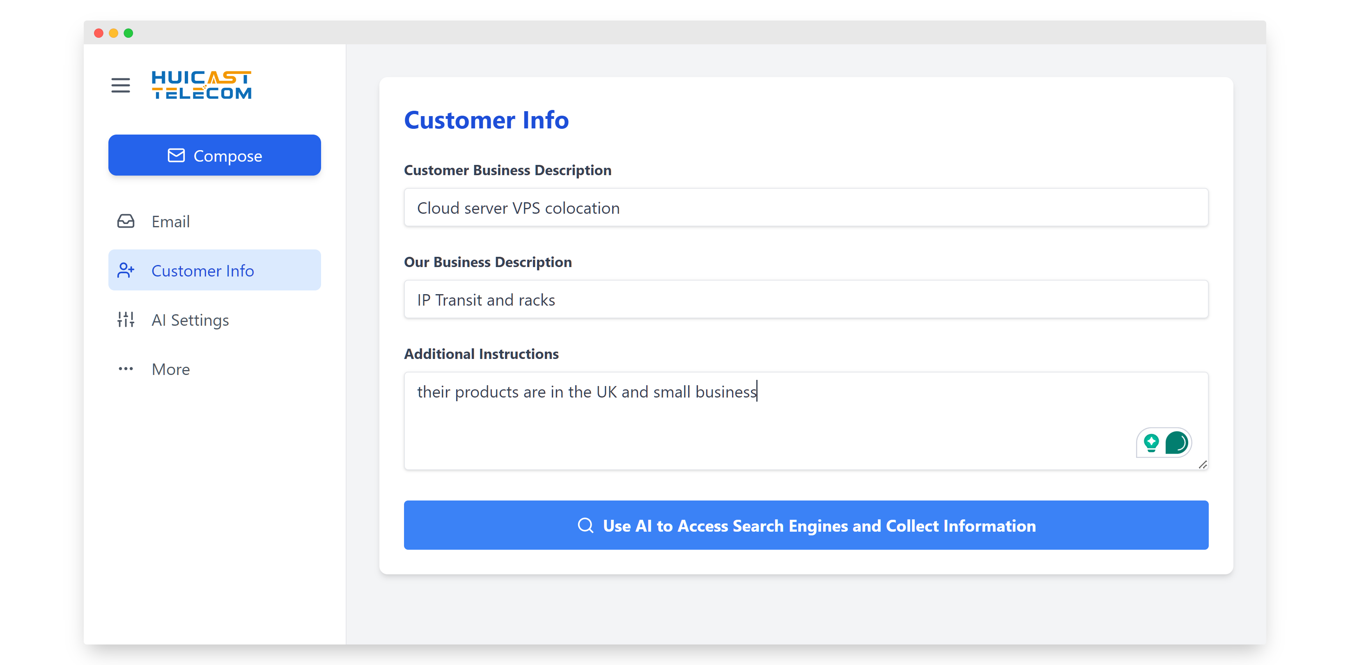

Slide 19
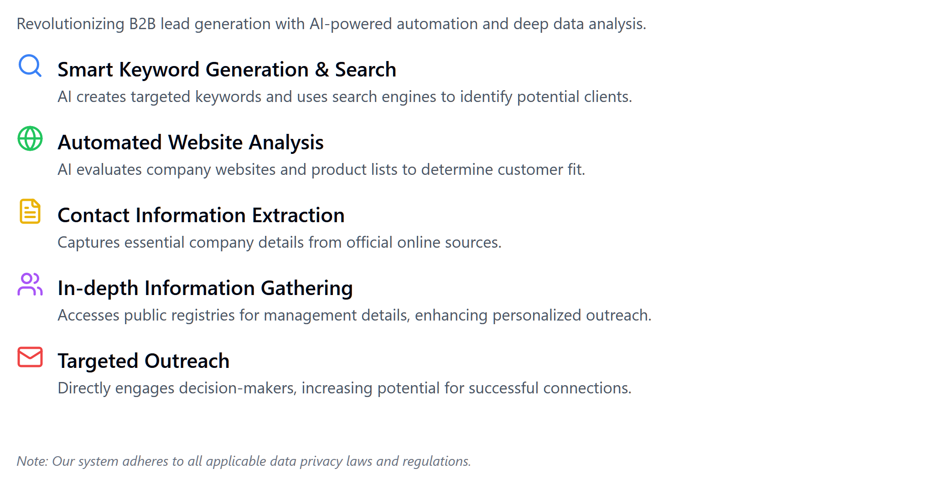
AI Potential Customer Discovery System

Slide 20
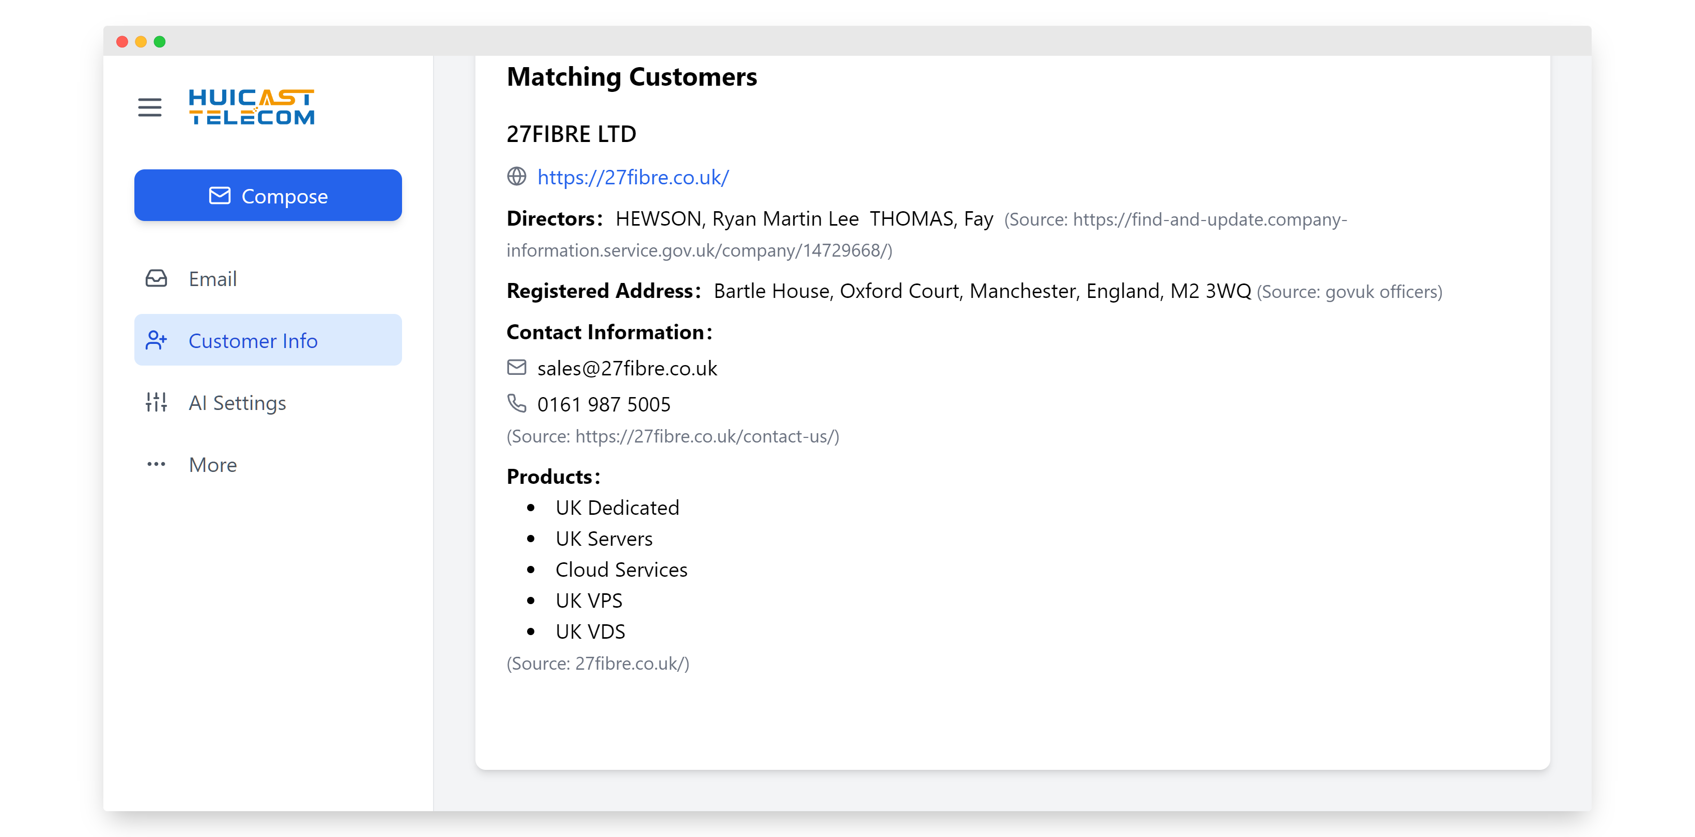

Slide 21
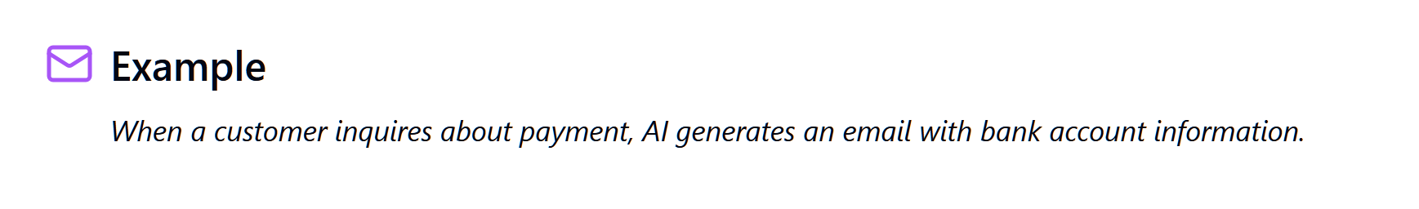
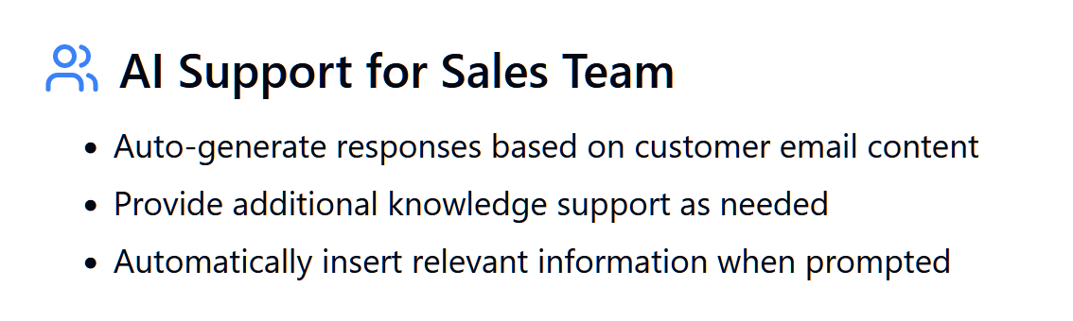
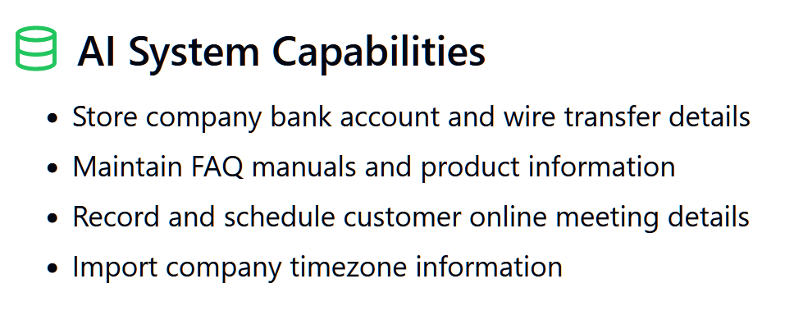
AI-Assisted Email Composition

Slide 22
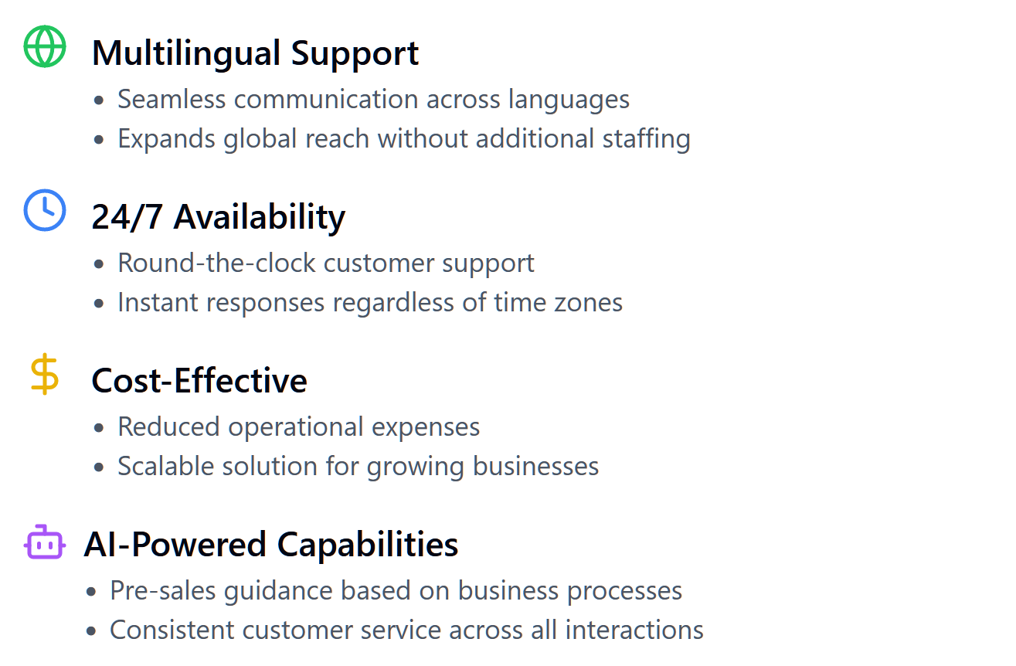
Chatbot Customer Service Solution

Slide 23
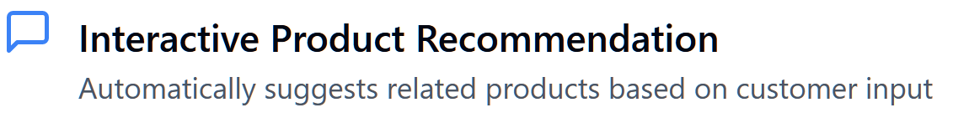
Chatbot Scenario-Based Applications
After customers input their desired products, the Chatbot automatically recommends related products.

Slide 24

Chatbot Scenario-Based Applications
Supports recommending complementary products based on the customer's selected items. For example, when a customer inquires about curtains, it automatically suggests curtain rods of matching colour and style.

Slide 25
Chatbot Scenario-Based Applications
Provides product images for customer reference (not included in demonstrations).

Slide 26
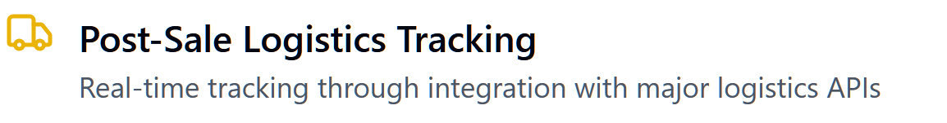
Chatbot Scenario-Based Applications
Integrates with APIs of major logistics platforms to enable real-time tracking of post-sale logistics.

Slide 27
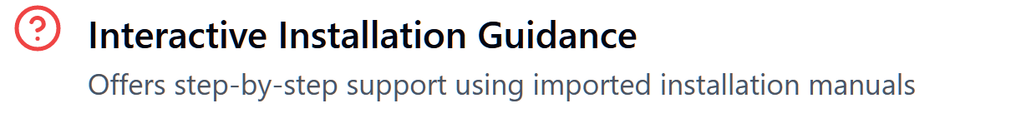
Chatbot Scenario-Based Applications
Achieves interactive installation guidance by importing installation manuals into the Chatbot.

Slide 28
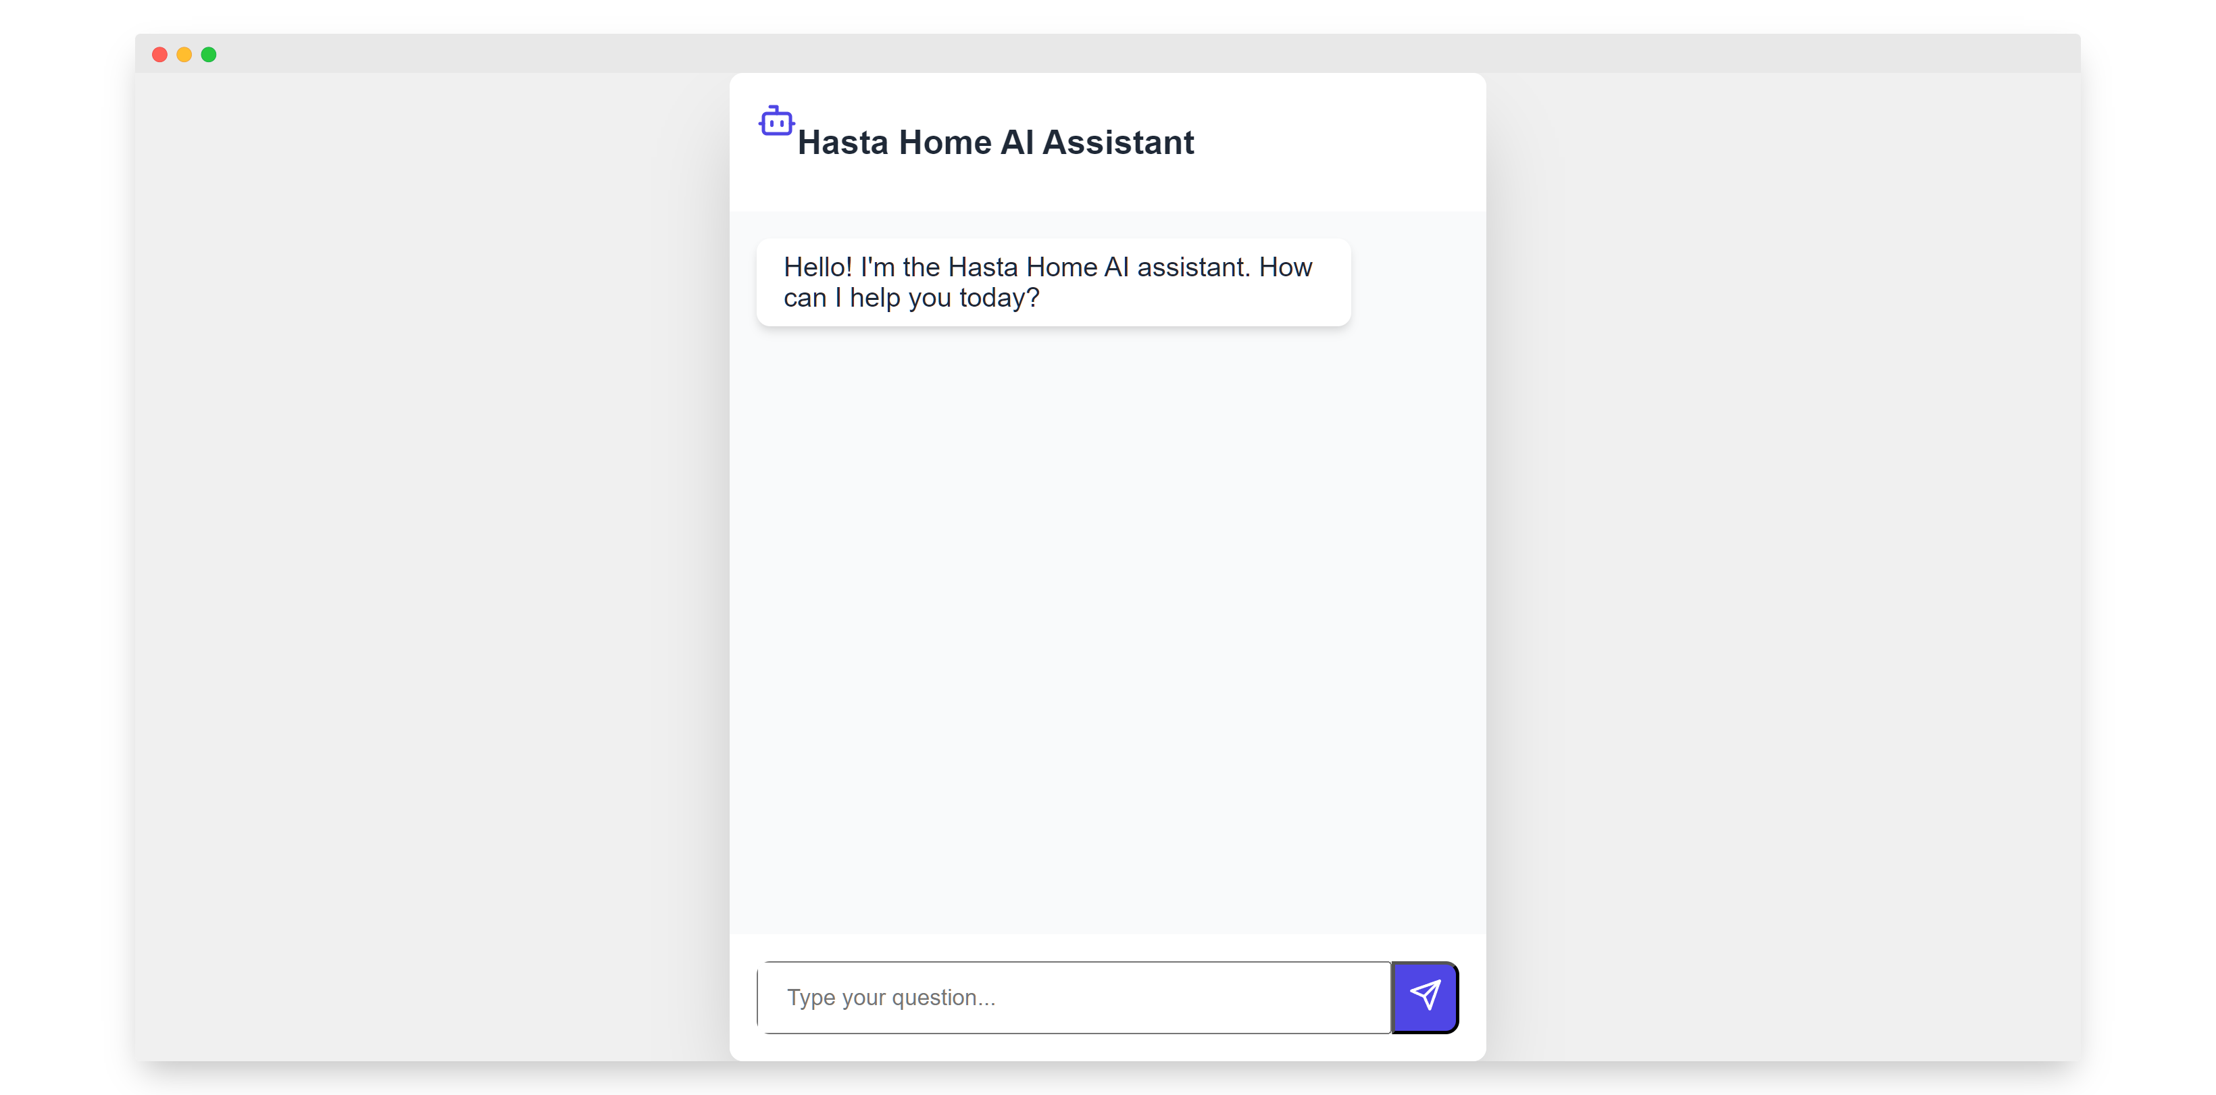
Chatbot Pre-Sales Robot Demonstration
Start

Slide 29
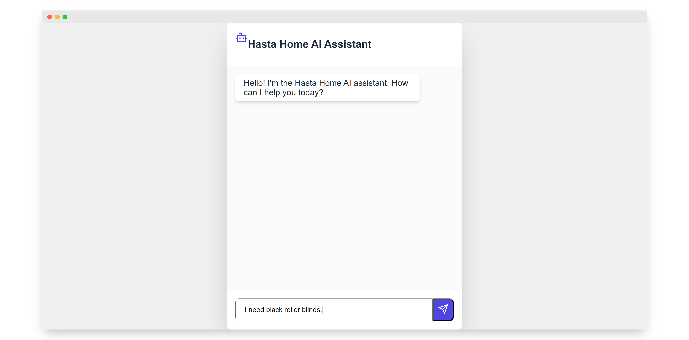

Slide 30
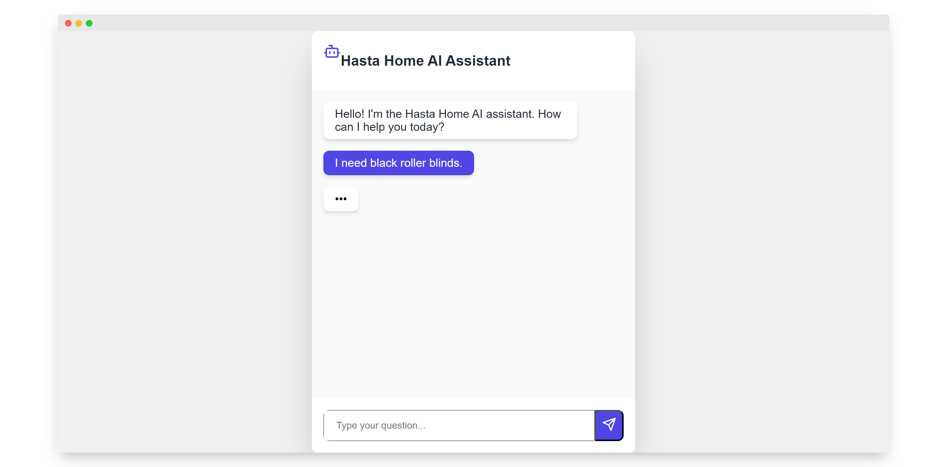

Slide 31


Slide 32
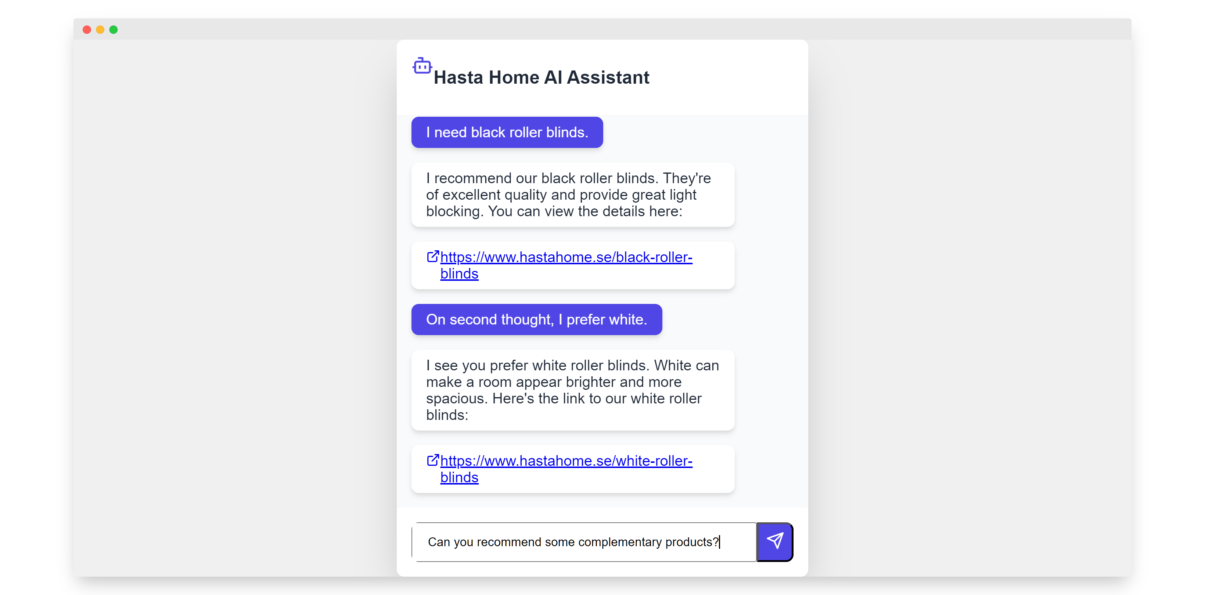

Slide 33
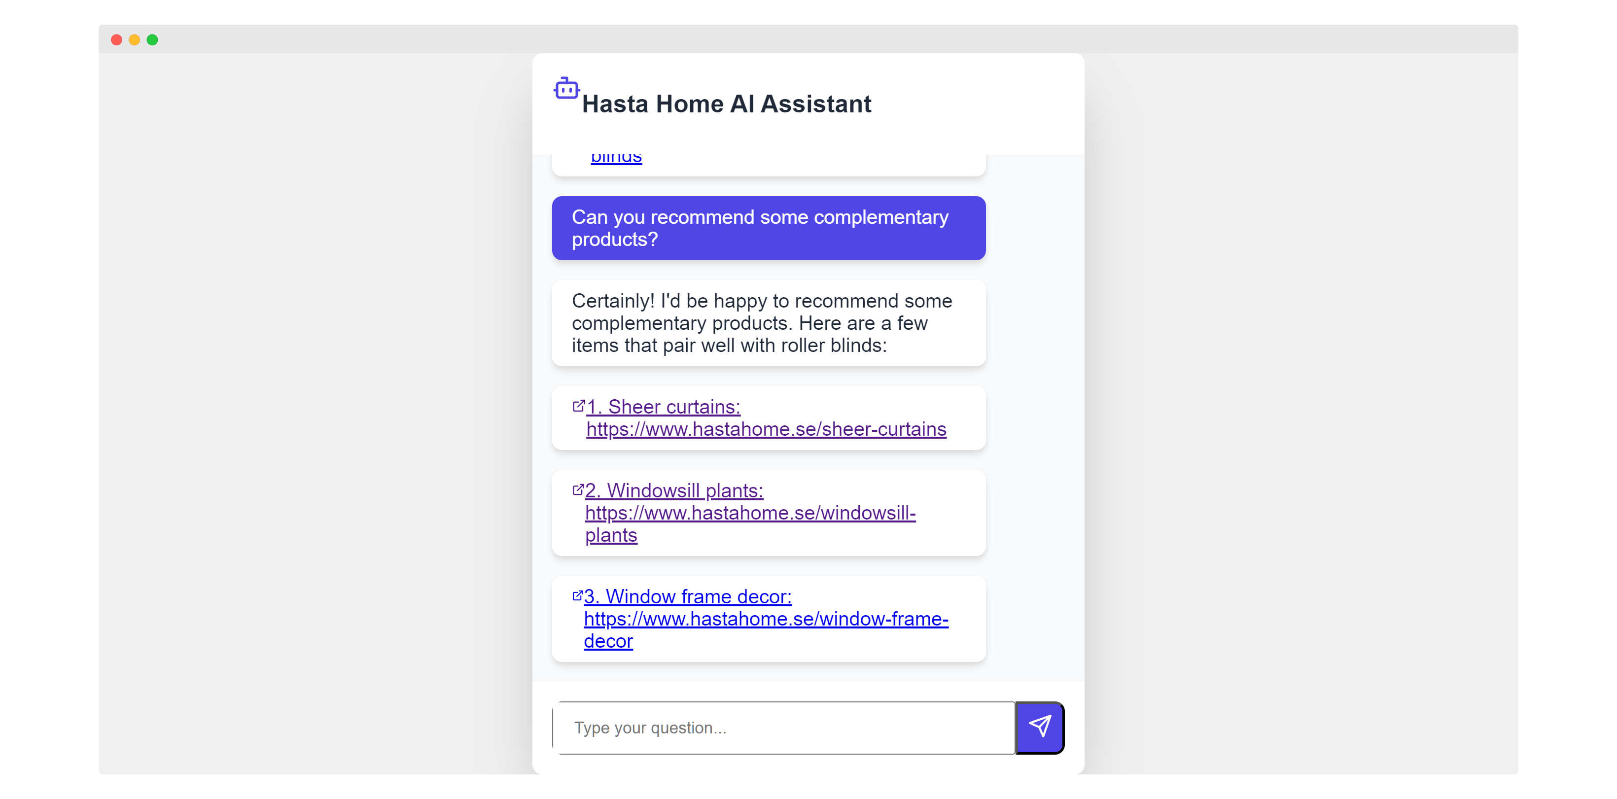

Slide 34

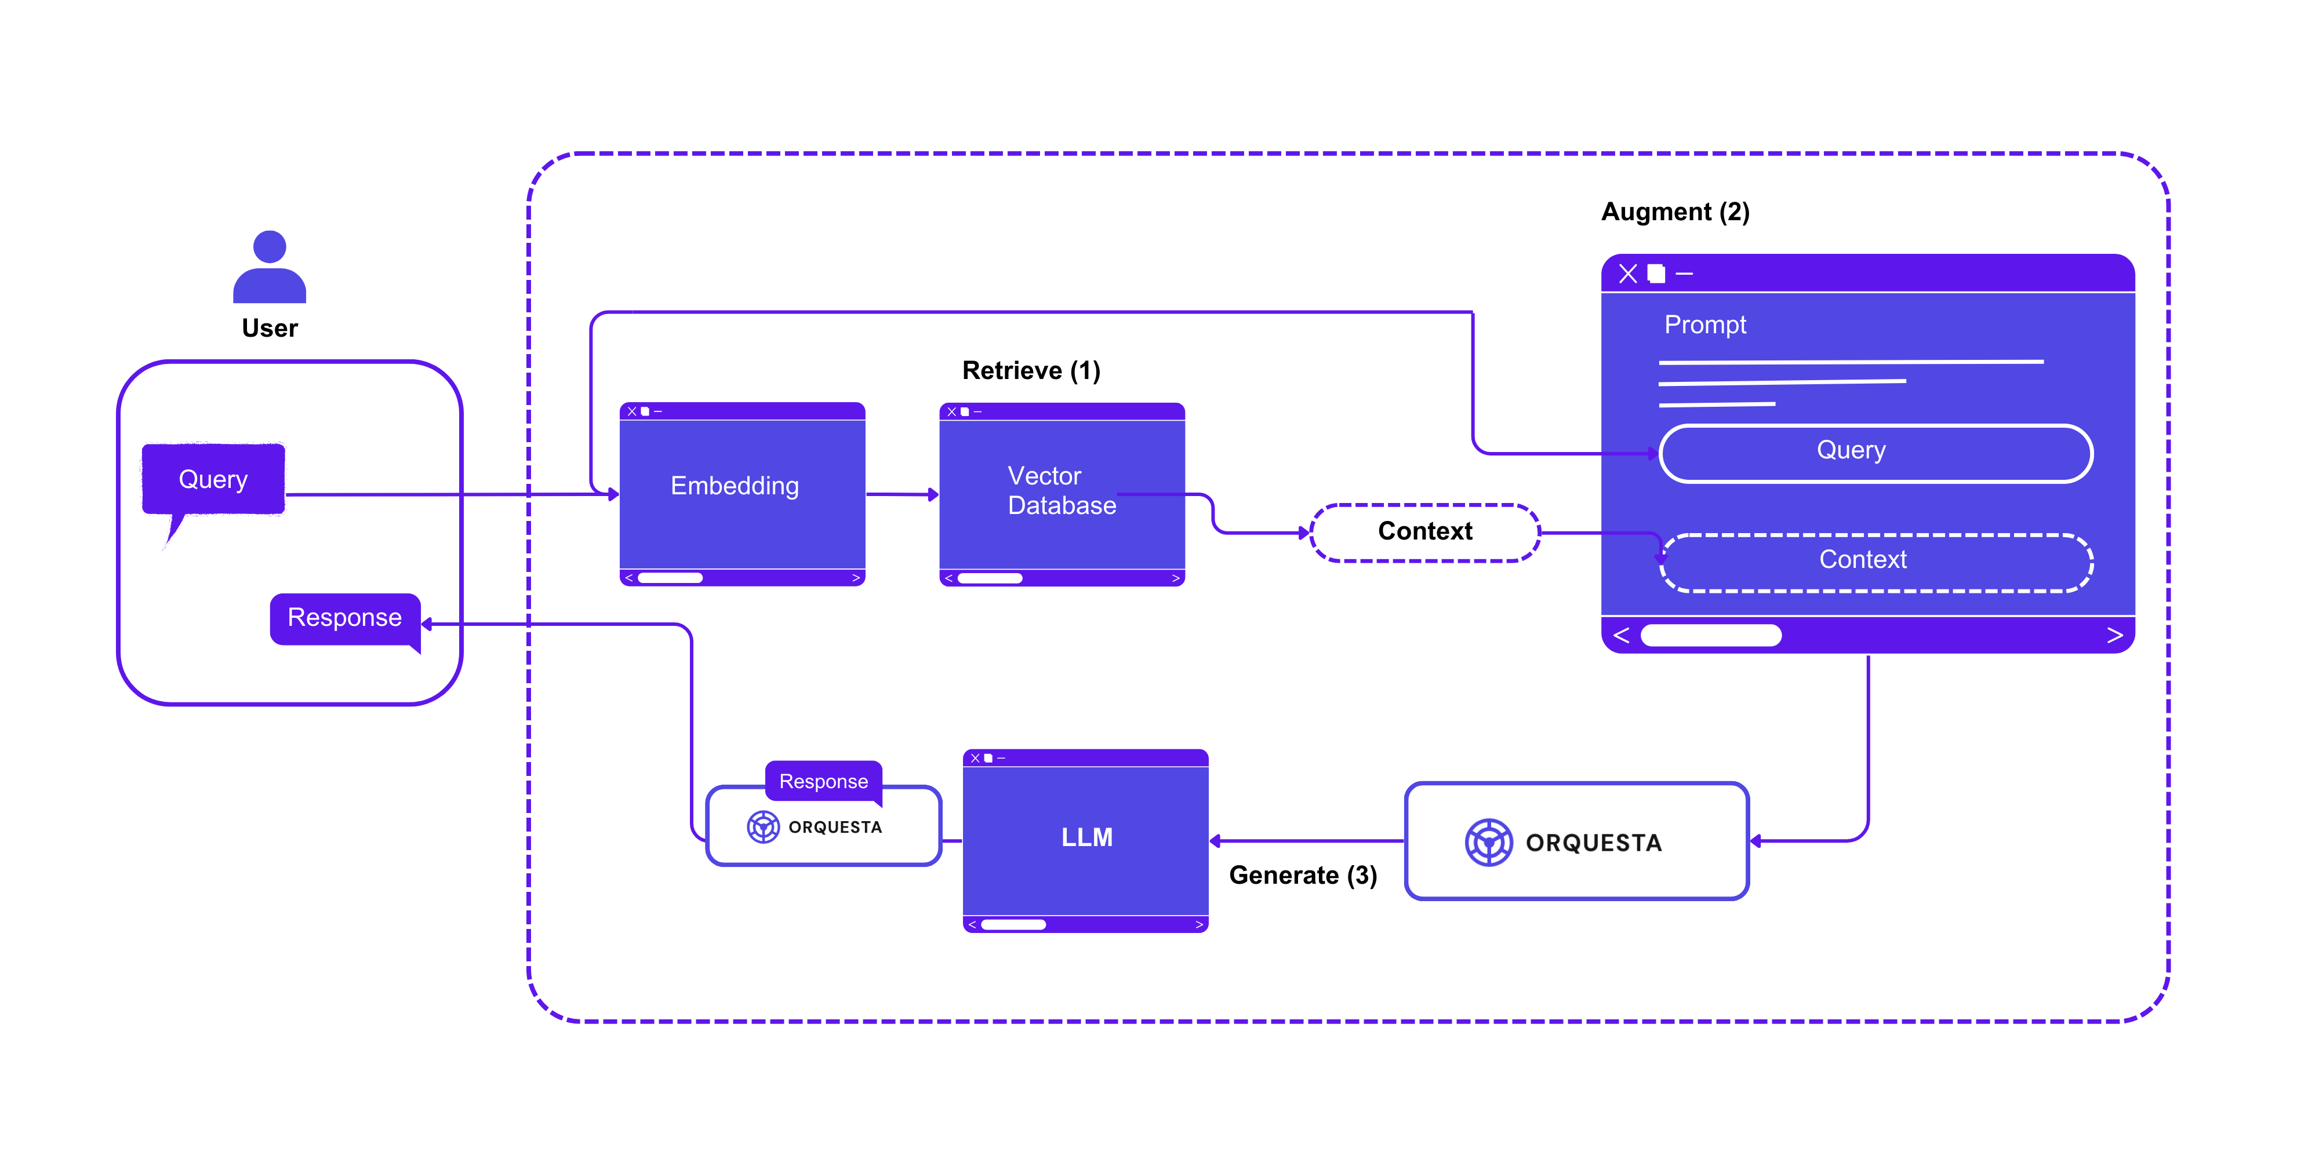
Implementation: Retrieval-Augmented Generation (RAG)
Retrieval-Augmented Generation (RAG) is a process for optimizing the output of large language models by referencing authoritative knowledge bases beyond their training data sources before generating responses.

Slide 35
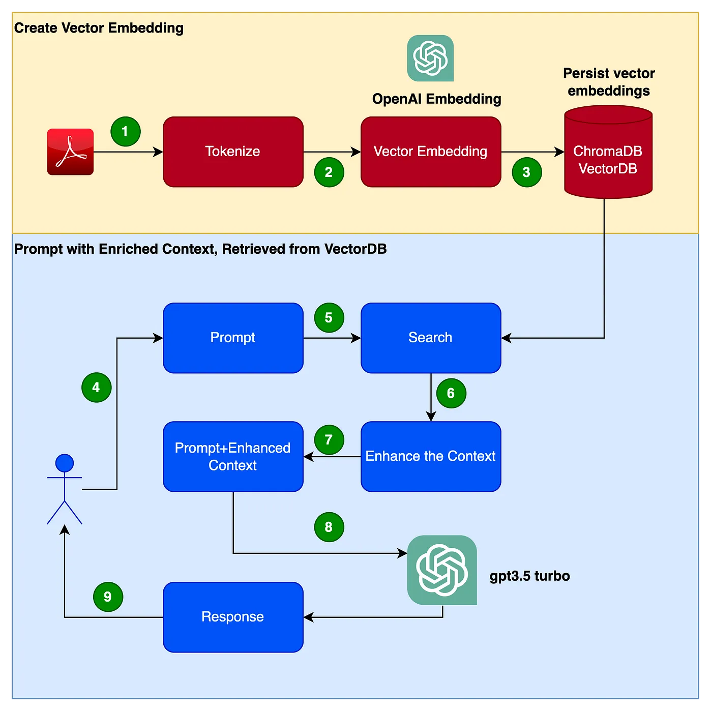
Chatbot Implementation Flowchart

Slide 36
Chatbot Solution Customization Process
1. Business Understanding
Clients provide business manuals and materials to help us understand their business model.
2. Chatbot Logic Design
We design Chatbot logic flow that meets business requirements based on the business model.
3. Data Integration
Implement data reading according to the client's business model. This includes importing product lists and business materials into the Chatbot, and setting up database connections.

Slide 37
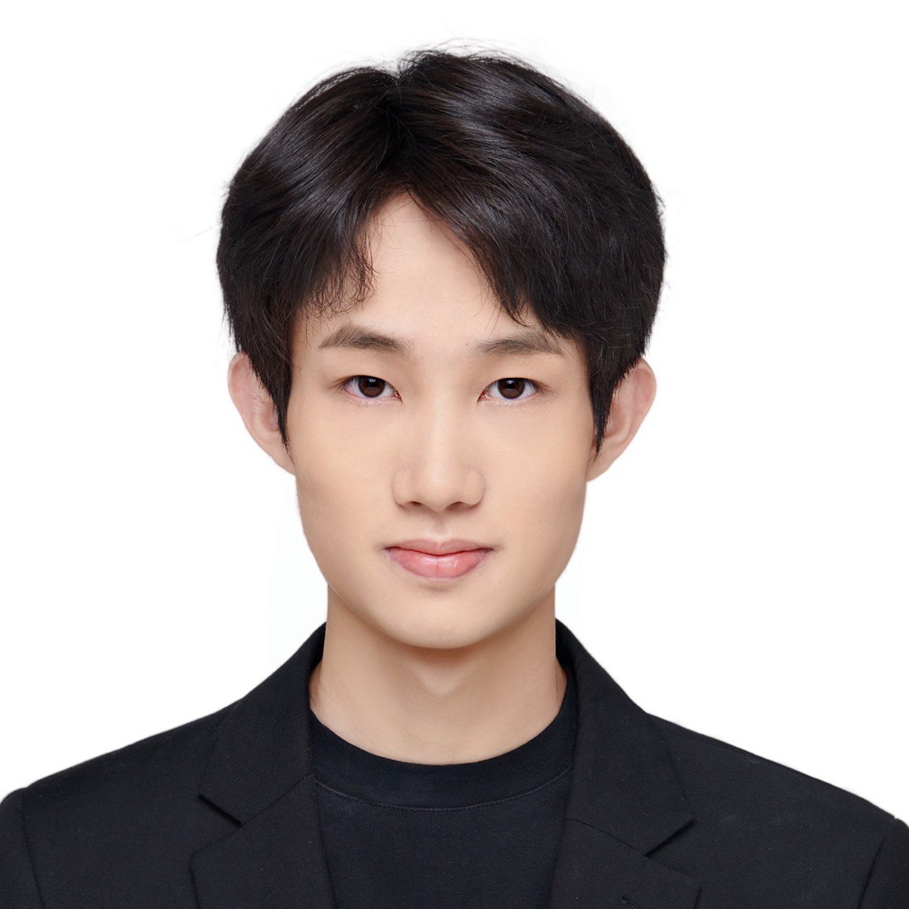

About me
Gaoxing Zhang
Chief technology officer at Huicast Telecom Limited

Slide 38
THANKS!
DO YOU HAVE ANY QUESTIONS?
📧brandon@huicast.com
📱+86 191 5797 5247 (Mainland China)
🌐+33 7 44 75 58 57 (International)

